Slide 1
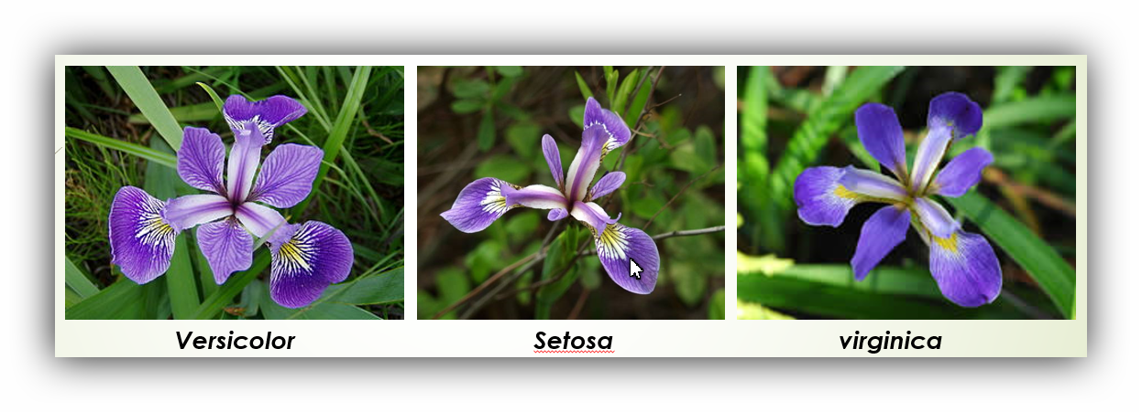
IRIS FLOWER CLASSIFICATION
Present: Vu Khanh Du

Slide 2
Agenda
Exploratory Data Analysis
Correlations between Variables
Classification

Slide 3
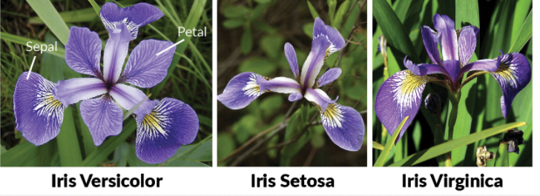
1. Exploratory Data Analysis
Dataset: UCI Machine Learning Repository (http://archive.ics.uci.edu/ml/datasets/Iris)
This dataset contains four features (length and width of sepals and petals) of 50 samples of three species of Iris.

Slide 4
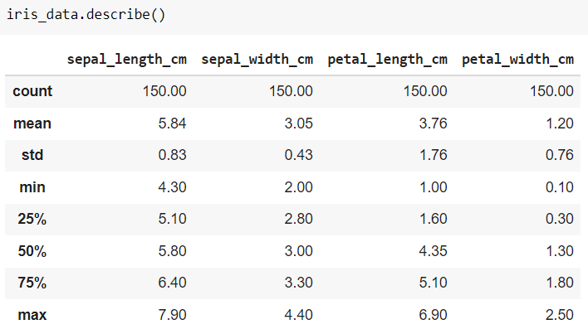
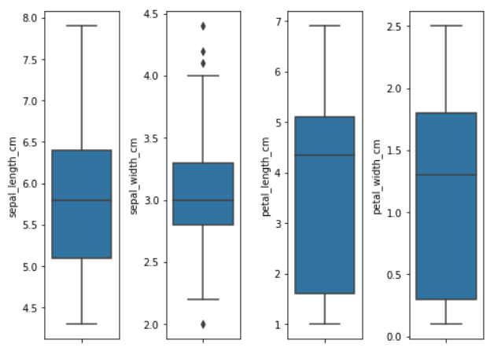
1. Exploratory Data Analysis

Slide 5
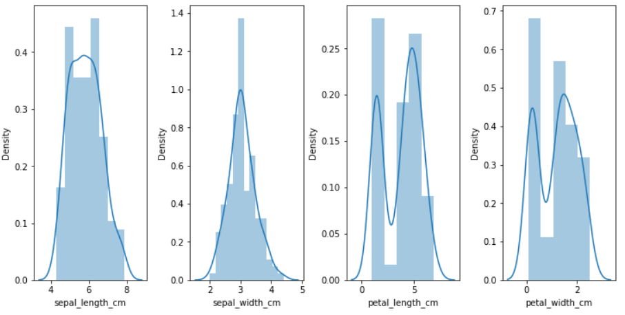
1. Exploratory Data Analysis

Slide 6
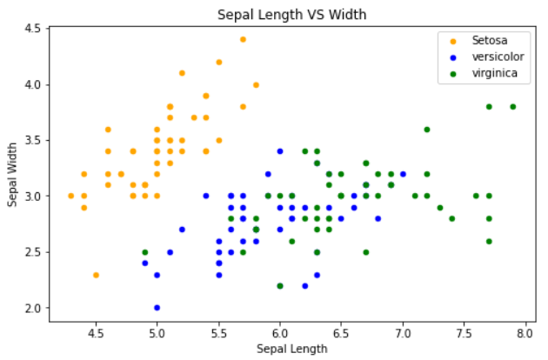
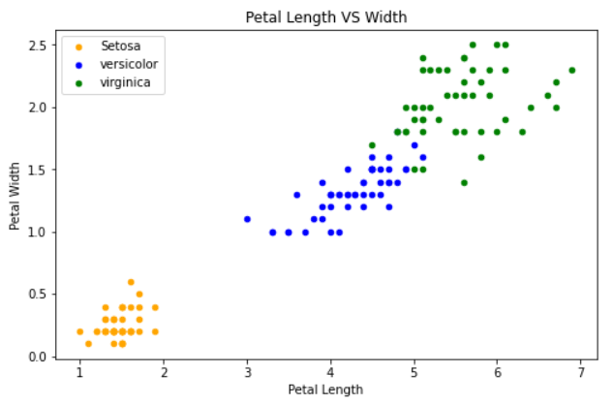
2. Correlations between Variables
Petal Features are giving a better cluster division compared to the Sepal features.
➔ Petals can help in better and accurate Predictions over the Sepal.

Slide 7
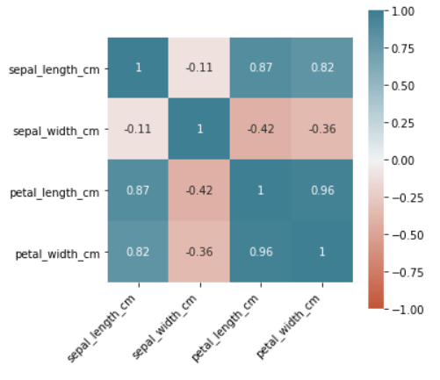
2. Correlations between Variables
The Sepal Width and Length are not correlated.
The Petal Width and Length are highly correlated.

Slide 8
3. Classification
Use all the features for training the algorithm and check the accuracy.
Use 1 Petal Feature and 1 Sepal Feature to check the accuracy
Steps when applying an Algorithm:
Split the dataset into training and testing dataset
Select any algorithm based on the problem
Then pass the training dataset to the algorithm to train it. (use the .fit() method)
Then pass the testing data to the trained algorithm to predict the outcome. (use the .predict() method)
We then check the accuracy by passing the predicted outcome and the actual output to the model.

Slide 9
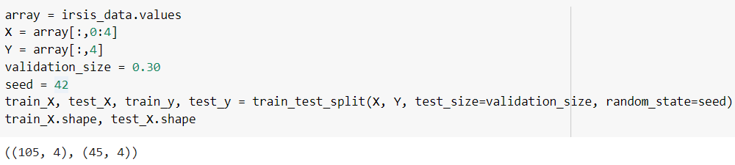
3. Classification (use all features)
Split the dataset into training and testing dataset

Slide 10
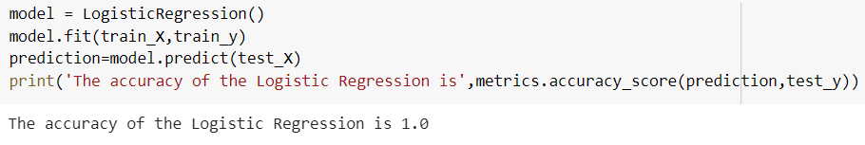
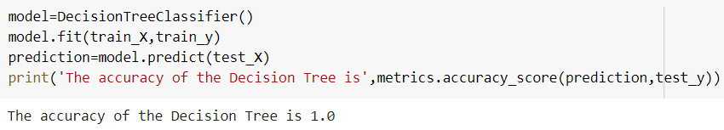
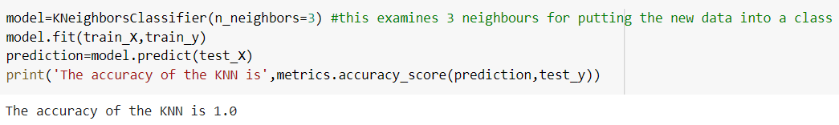
3. Classification (use all features)
Logistic Regression
Decision Tree
K-Nearest Neighbours

Slide 11
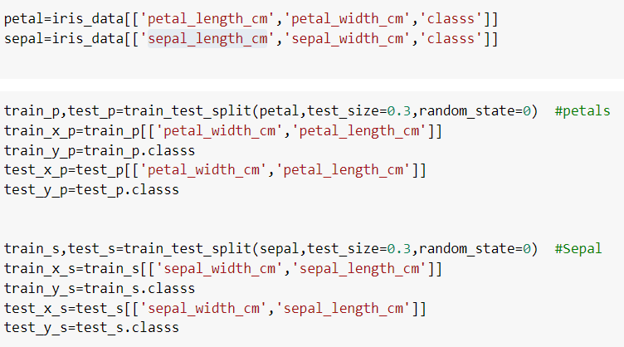
3. Classification (use 1 feature)
Split the dataset into training and testing dataset

Slide 12
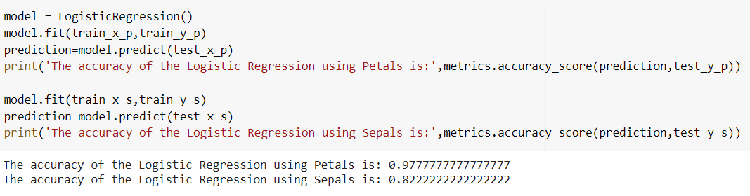
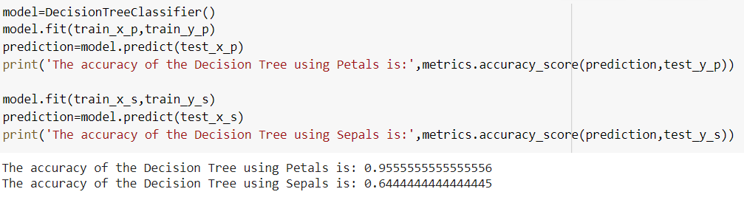
3. Classification (use 1 feature)
Logistic Regression
Decision Tree

Slide 13
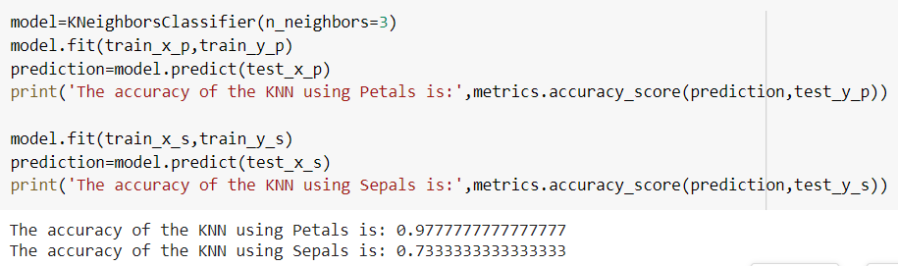
3. Classification (use 1 feature)
K-Nearest Neighbours
➔ Conclusion: Using Petals over Sepal for training the data gives a much better accuracy.

